Slide 1
Insurance AI Project
Presented by Bowthiran

Slide 2
Project Overview
This project is an AI-driven solution designed to improve the efficiency, accuracy, and security of operations in the insurance domain. It combines multiple machine learning models, natural language processing techniques, and transformer based architectures to address real-world challenges such as risk classification, claim amount prediction, customer segmentation, fraud detection, sentiment analysis, insurance document translation, policy summarization, and automated answering chatbot.

Slide 3
Business problem
Hard to Judge Risk It's difficult to correctly tell which customers are more likely to make risky or expensive claims.
Fake Claims Some people try to cheat the system and file fake insurance claims, which causes big money losses.
Slow Claim Processing Reviewing claims by hand takes time and causes delays in giving money back to customers.
Companies often give the same kind of policy to everyone, so customizing it for each customer’s needs.
Language Issues Customers who don’t speak the same language as the company can’t understand policies or get help easily.
Bad Customer Experience Customers get frustrated with long documents and waiting a long time to get answers to their questions.

Slide 4
Proposed solution
Enables personalized pricing, improving customer acquisition & retention by 15–20%.
Supports faster claim decisions and better resource allocation. reduces customer churn by 25%.
Saves millions in fraudulent payouts. Reduces fraud related losses by up to 40%.
Increases policy conversion rates and cross sell opportunities.
Helps address negative feedback early. Boosts customer satisfaction and loyalty.
Reduces language barriers and improves accessibility.
Makes complex policies easier to understand. Improves customer trust and decision making.
Cuts customer support costs by 30–40%. Offers instant responses, improving user experience.

Slide 5
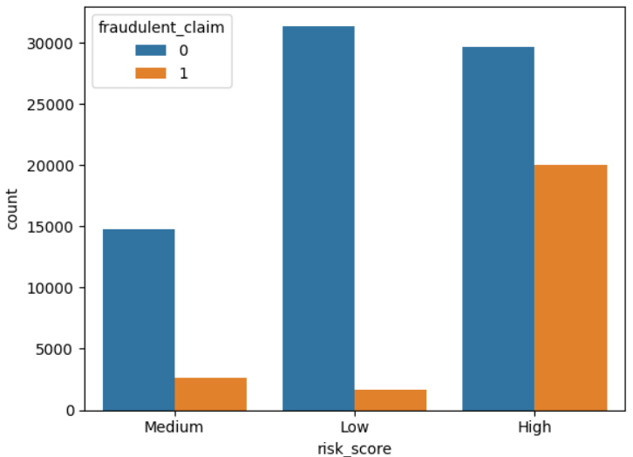
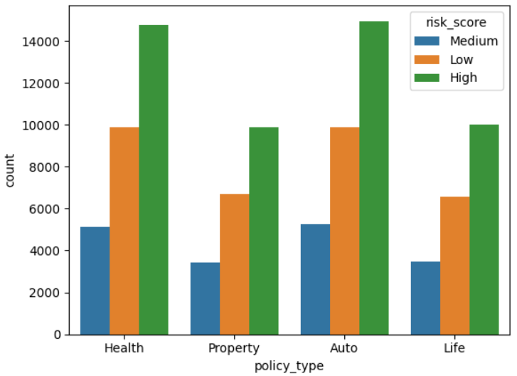
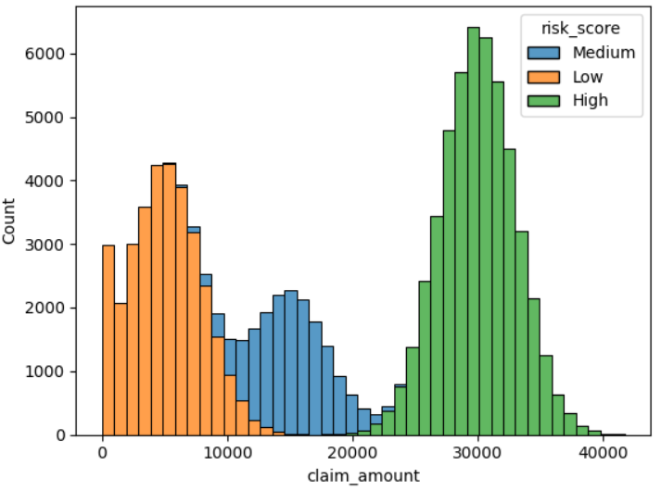
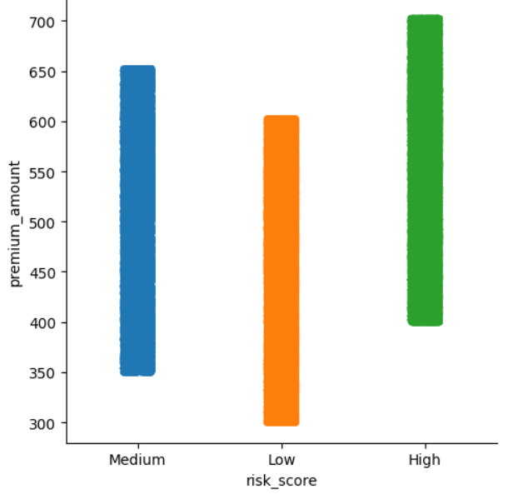

Slide 6
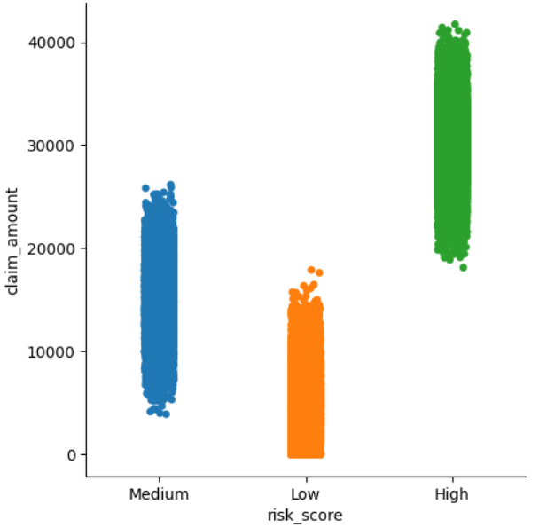
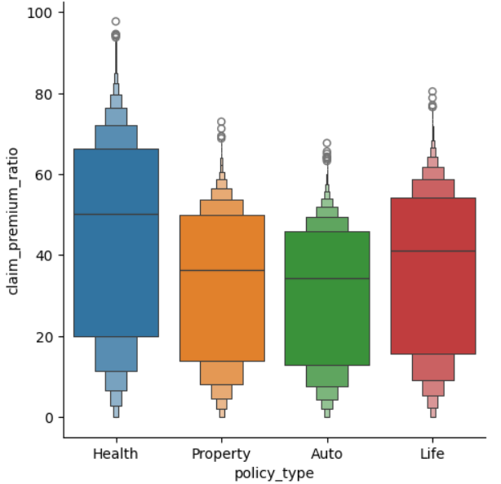
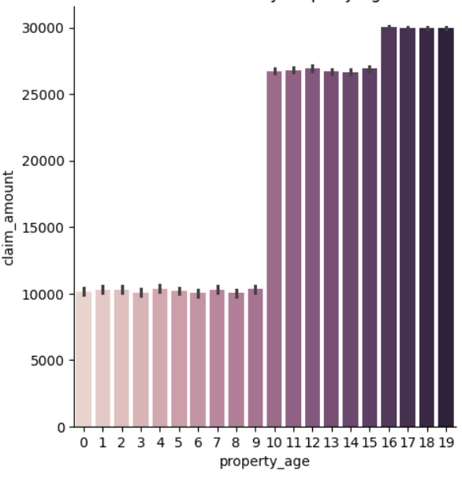
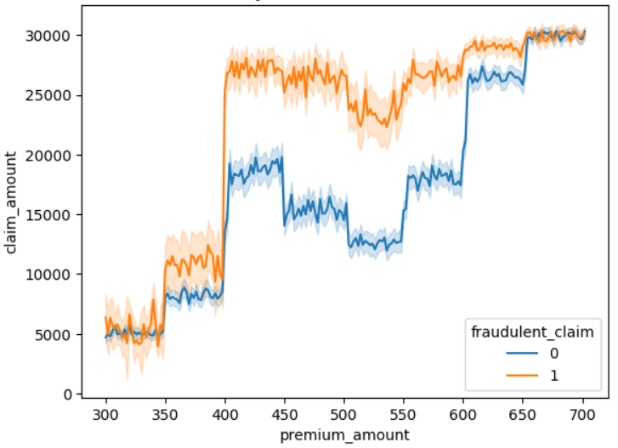

Slide 7
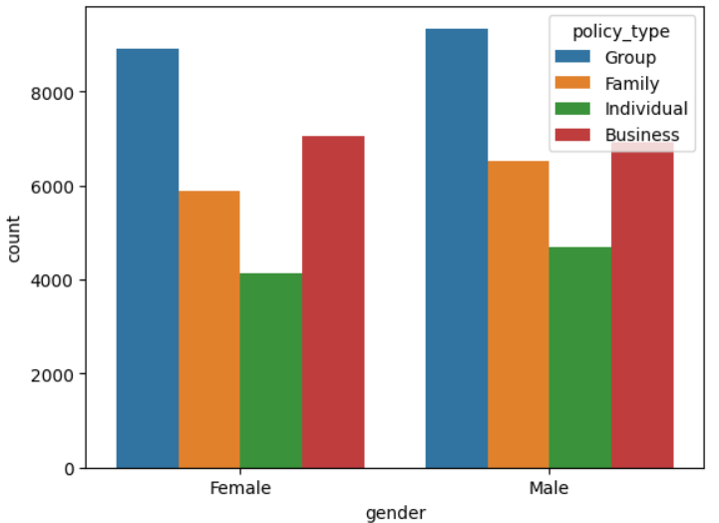
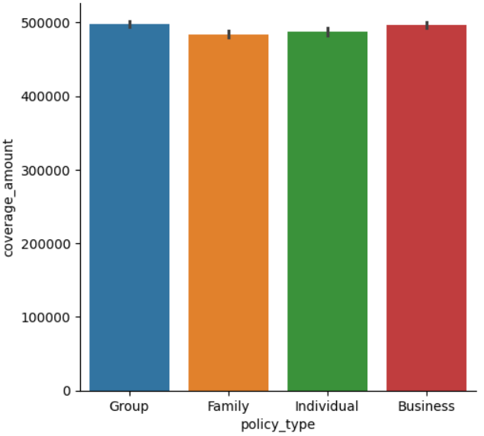
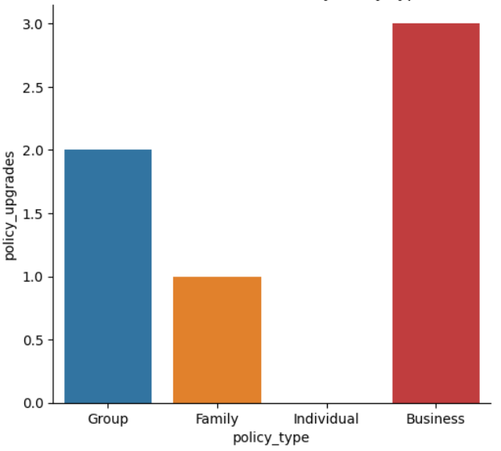
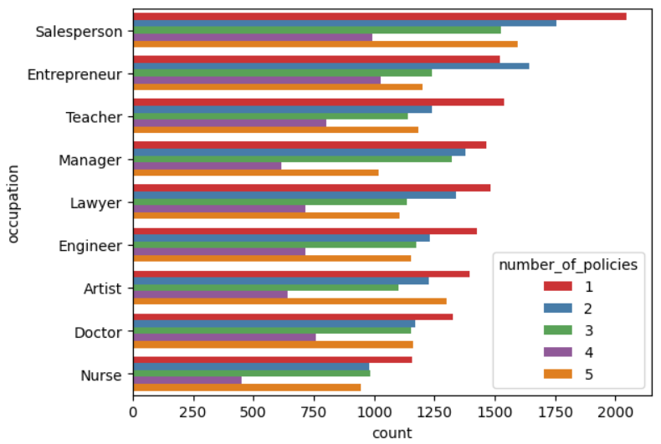

Slide 8
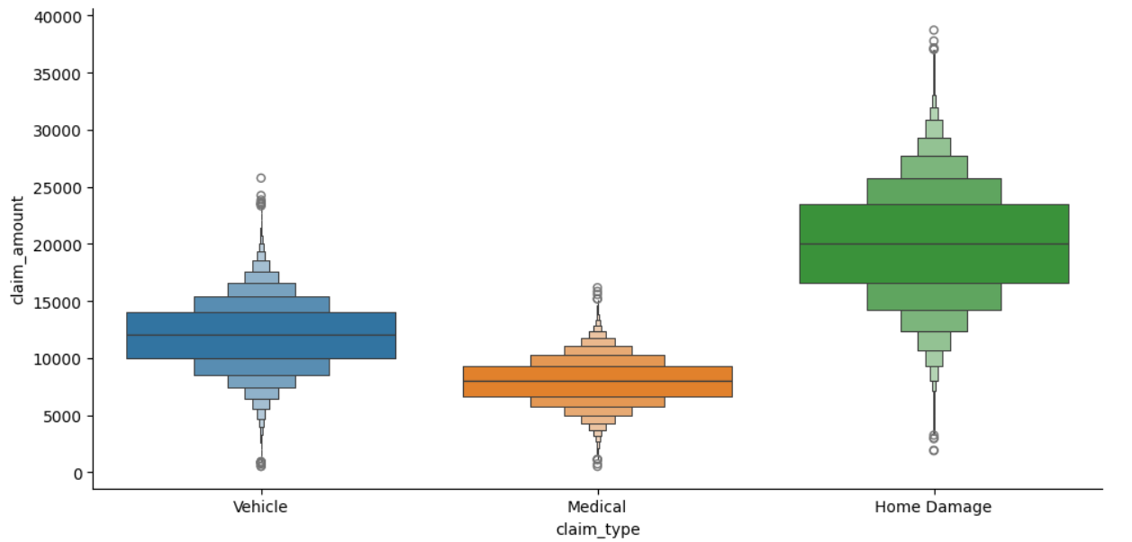
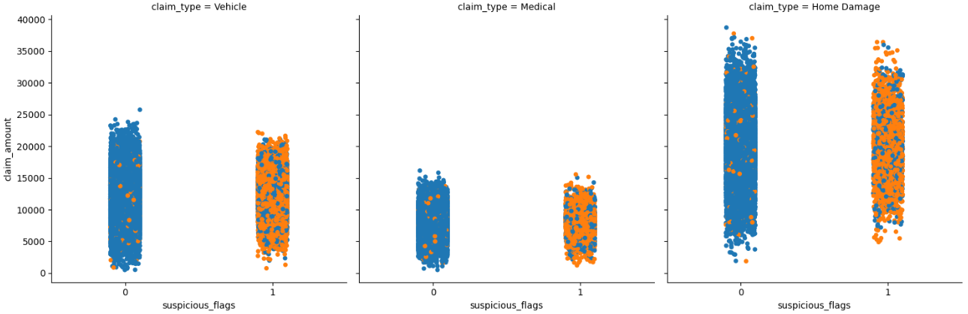

Slide 9
Insights
If risk score is High, the number of fraudulent claims is also high.
most claims are made by people with a High risk score, especially in Health and Auto insurance.
Large claims are most common in the High risk, which also had more fraudulent claim activity.
People with High risk scores pay higher premiums, because they are more likely to claim large amount or fraudulent claims.
Health, Life insurance policies show the highest claim premium ratio compared to other policy types.
older properties might be more prone risk, resulting in higher claim values.
People who pay a high premium amount sometimes claim a large amount, which can indicate the higher chance of fraud claim.

Slide 10
Customer segmentation
For both genders, Group policies have the highest count, while Individual policies have the lowest.
Group & Business policies have the highest coverage amount on average, while Family policies have the lowest.
Business policies have the highest average number of policy upgrades, Family policies have the lowest policy upgrades.
Salespersons purchase one or two policies. doctor, artist, engineer, lawyer are purchase same pattern so recommend policies same as well. nurse can focus to buy all type of policies.
FRUD DETECTION
Home damage claims often involve more extensive repairs or rebuilding, leading to higher overall costs compared to vehicle & medical claims.
If someone makes a home insurance claim and also has a suspicious flag, there is a high chance that the claim could be fraudulent.

